Slide 1
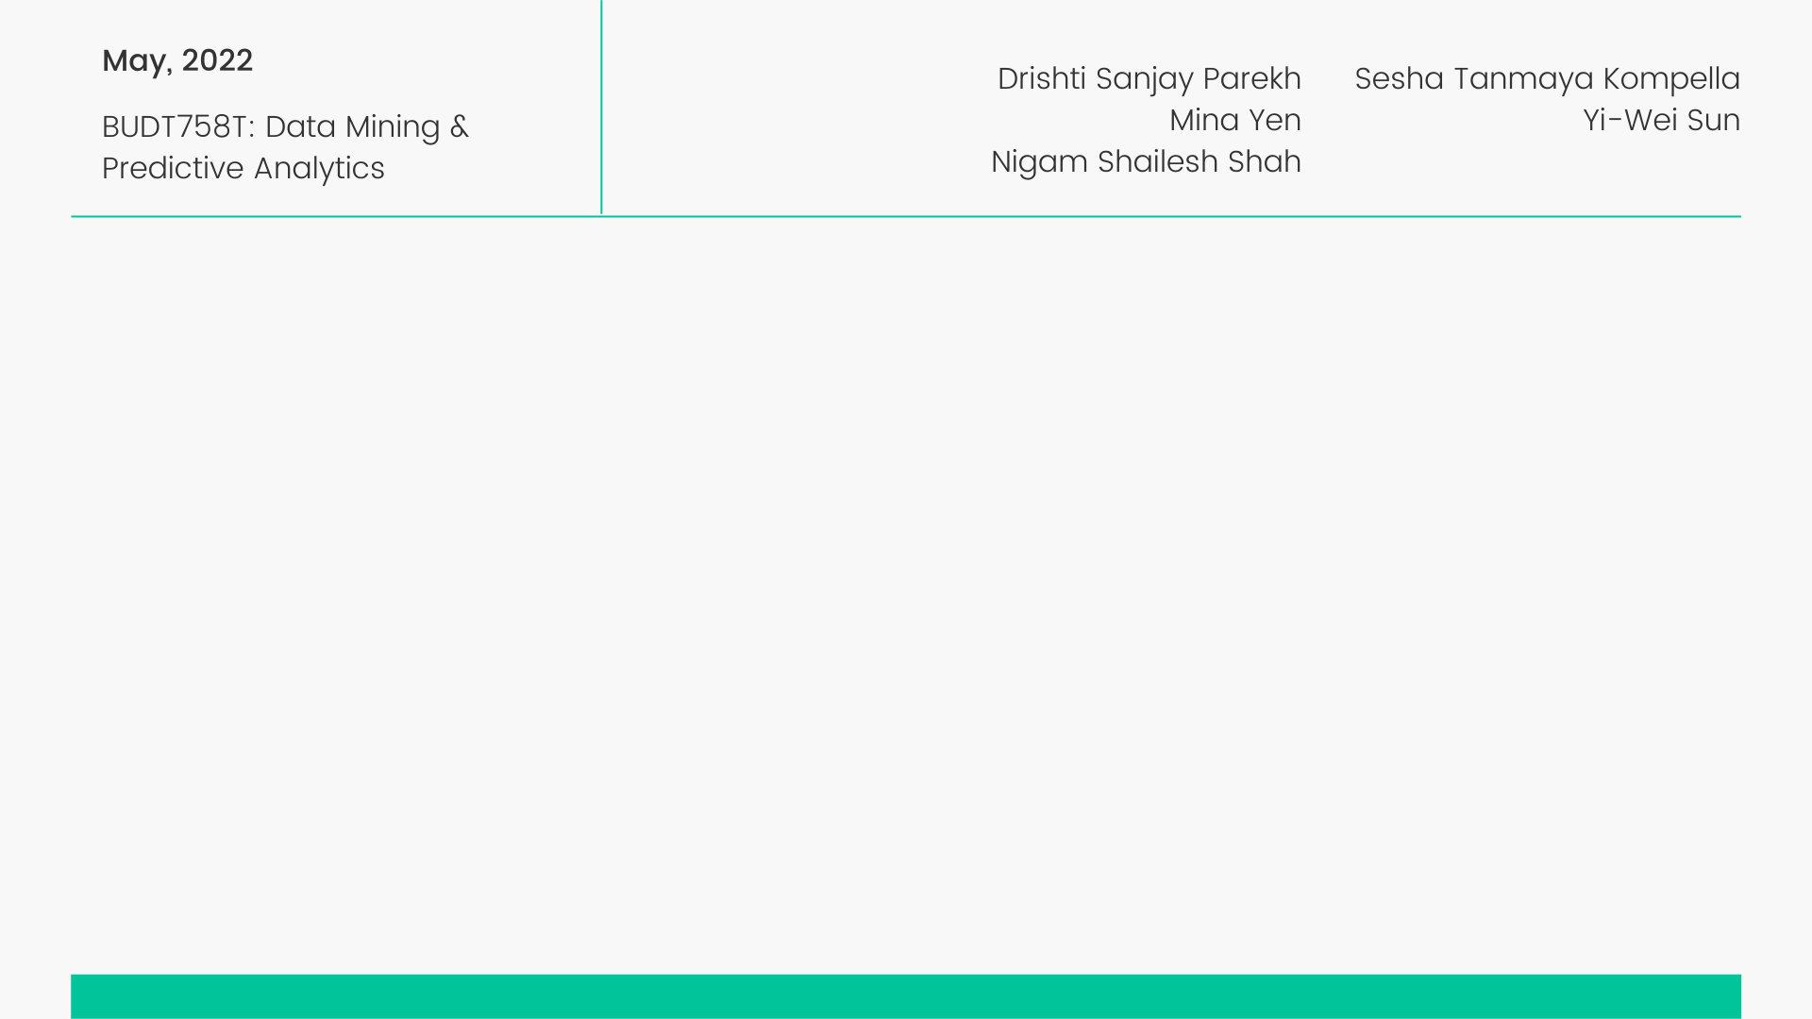
Mental Health
Classification Model Using ML

Slide 2

Agenda
Page
I
II
III
IV
V
Research Questions & Motivation
Workflow & Dataset Overview
Data Mining Methods
Results and Finding
Future Scope
3
xx
xx
xx
x

Slide 3

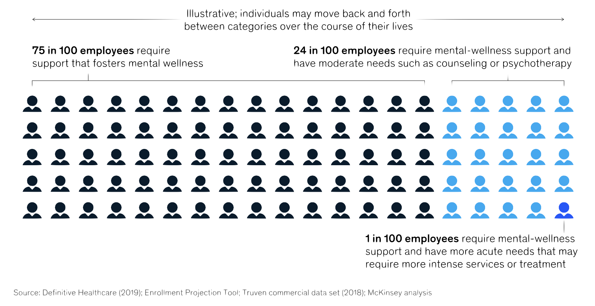
I
Research Questions & Motivation
Background
More than half of the population of middle and high-income countries are likely to suffer from at least one form of mental disorder during their lifetime
The start of the COVID-19 pandemic has only gotten the stats significantly worse
3

Slide 4

I
Research Questions & Motivation
Research Questions
Develop data mining models for the classification of the risk for poor mental health
  Which factors are related to having poor mental health?
Focus on people working in tech roles/industry
  Are these people more likely having mental health problem?
Analyze relationship between company and employee’s mental health
  Are employees working in company providing healthcare resources have better mental health?
4

Slide 5

II
Workflow & Dataset Overview
Project Workflow
Data Collection and Merging
Data Cleaning
Data Exploratory
Building Models
Model Comparison
Result and Finding
Logistic Regression
KNN
Naïve Bayes
Classification Tree
Random Forest
Cluserting
Association Rules
5

Slide 6

II
Workflow & Dataset Overview
Data Description
Data Source
Feature variables
Data Cleaning
OSMH/OSMI Mental Health in Tech Survey
124 features including target variable
Overall 1837 data points(combined from 2017 to 2021)
Select 21 variables related to our question
Mostly categorical variables
Dependent variable
MH_disorder (whether this person currently has mental health disorder)
Lots of mistype context in the data set which requires a lot of reorganization and renaming
6

Slide 7
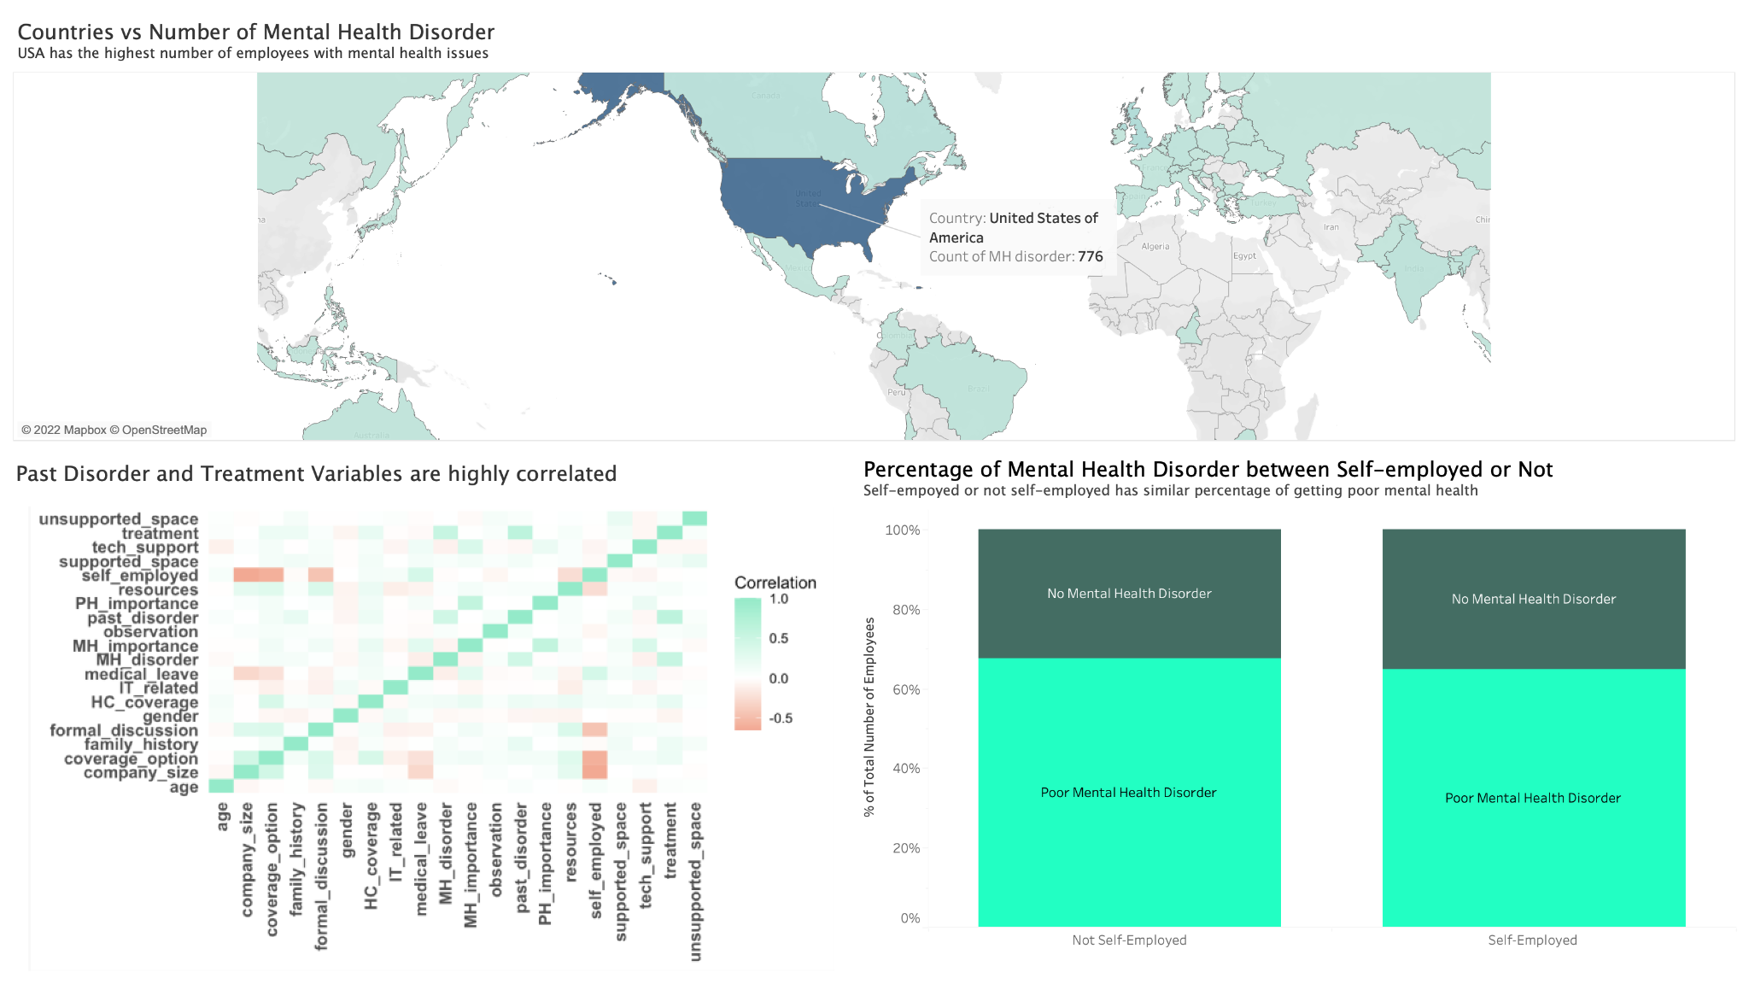
II
Workflow & Dataset Overview
Data Exploratory
7

Slide 8
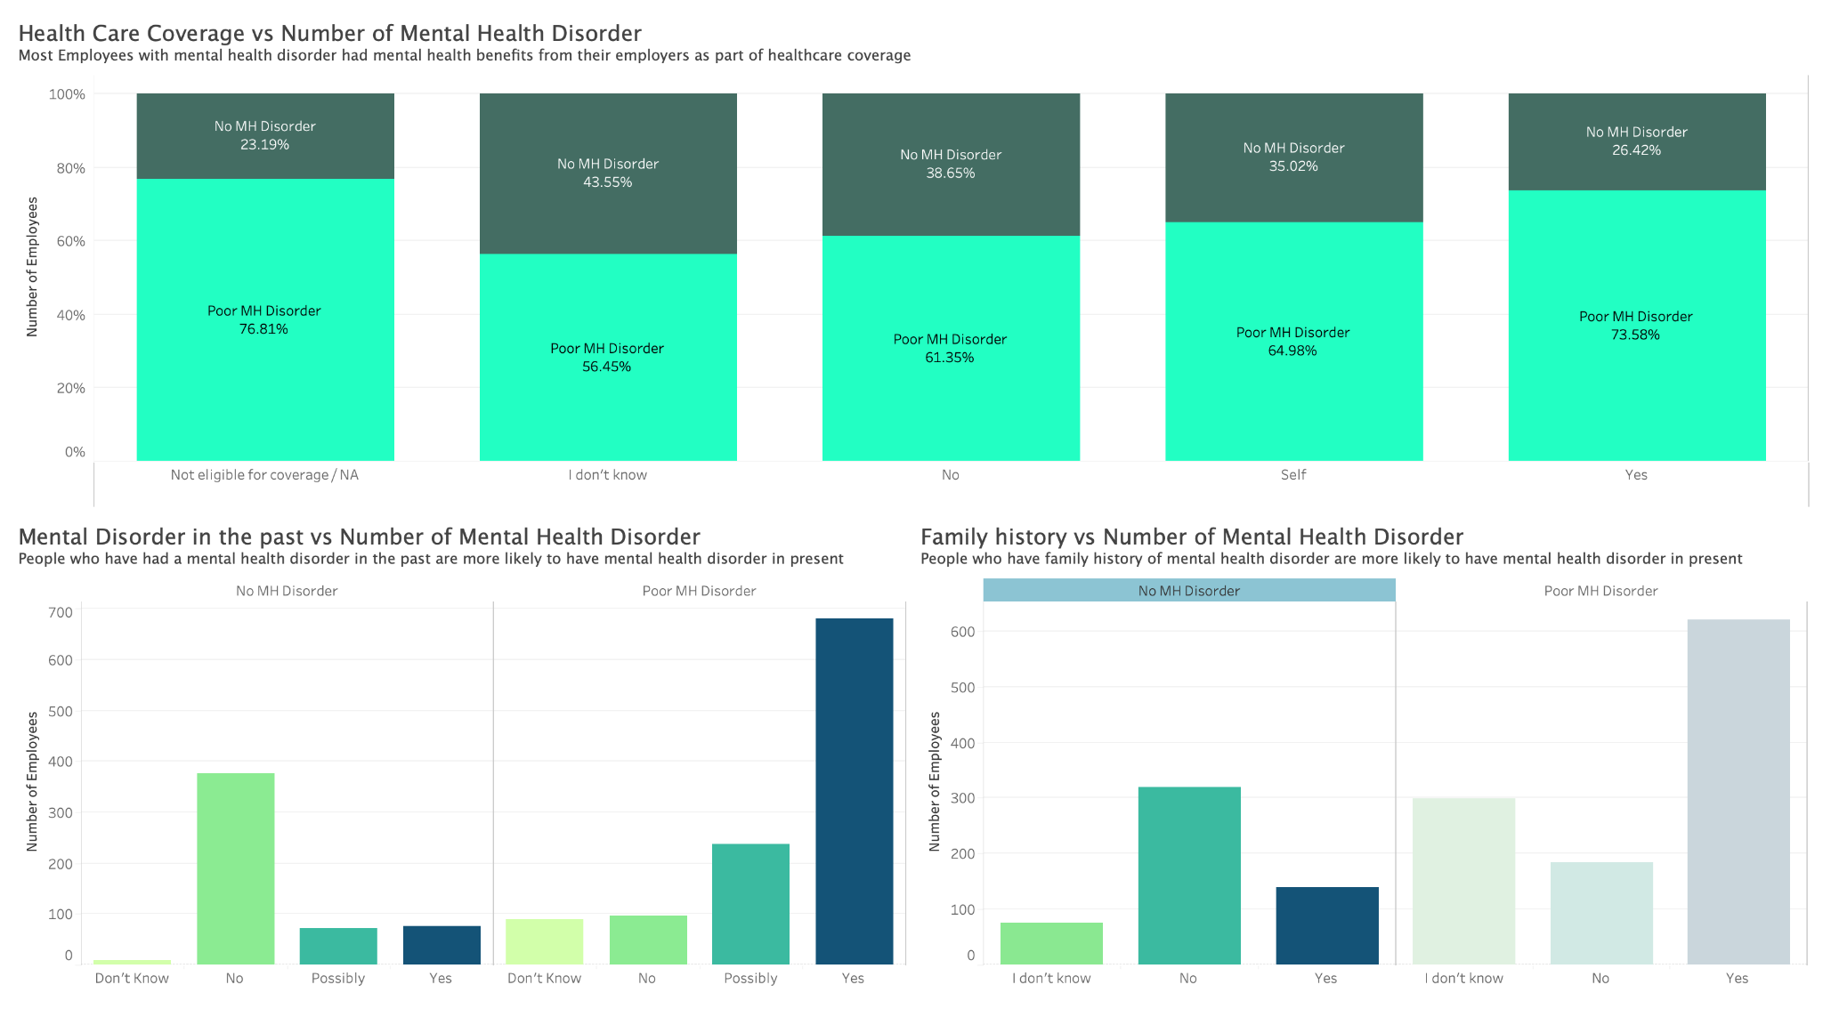
II
Workflow & Dataset Overview
Data Exploratory
7

Slide 9

III
Data Mining Methods
Models
Logistic Regression +
Feature Selection
Classification Tree
Random Forest
KNN
Naïve Bayes
Clustering
Association Rules
Run Through different variables and selected the best
All variables (Except “countries”)
Log Regression Selected variables
Top 8 Random Forest variables
9

Slide 10
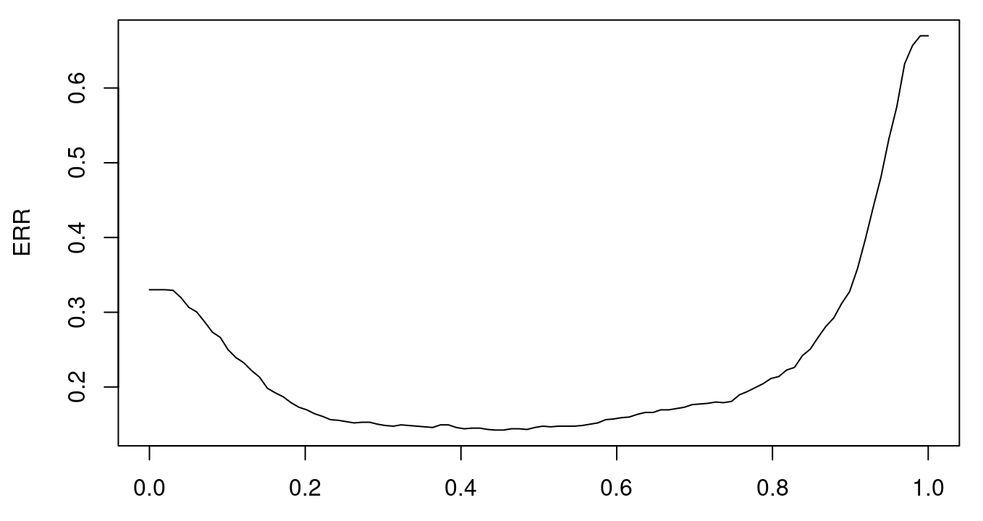
III
Data Mining Methods
Logistic Regression - Feature Selection
Backward Elimination
Remove features that do not have a significant effect on the dependent variable
Reduced the feature count from 49 to 17 features
Accuracy (test data) : 0.864
Note : The cutoff value used for the model is 0.5
0.44
Finding the best cutoff value with highest accuracy
New cutoff: 0.44
Cutoff value vs. Error rate
10

Slide 11
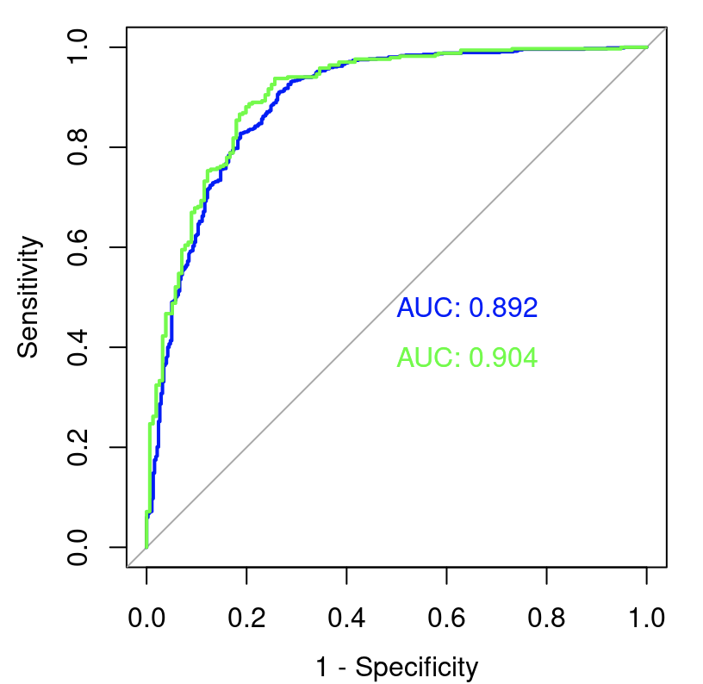
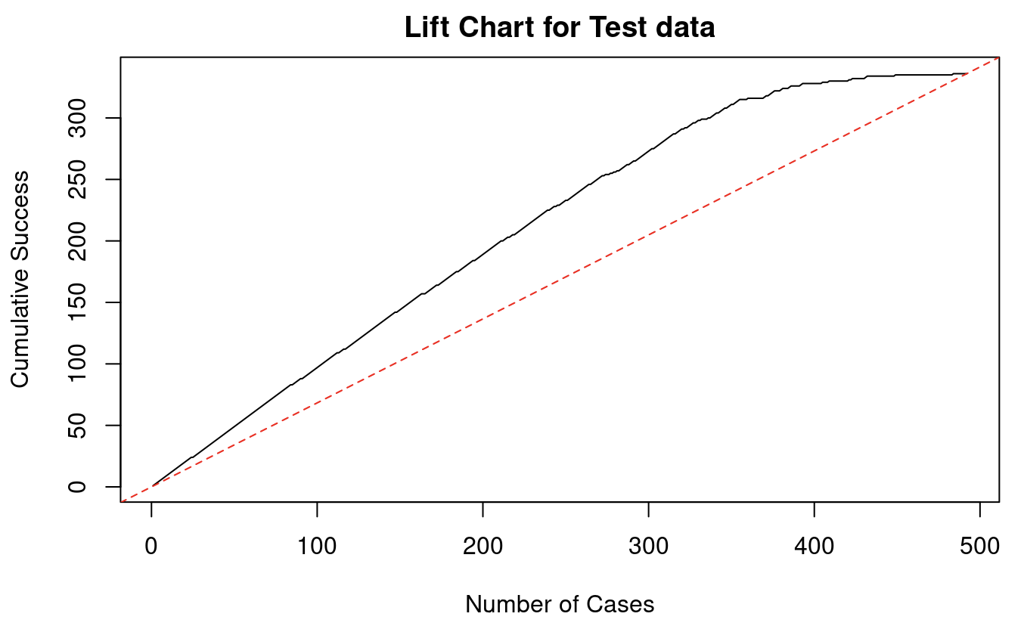
III
Data Mining Methods
Logistic Regression - Feature Selection
Using new cutoff value for Backward Elimination
Accuracy (test data): 0.8719 (Increased)
AUC (test data) : 0.904
Lift Chart for Test Data
ROC curve
11

Slide 12
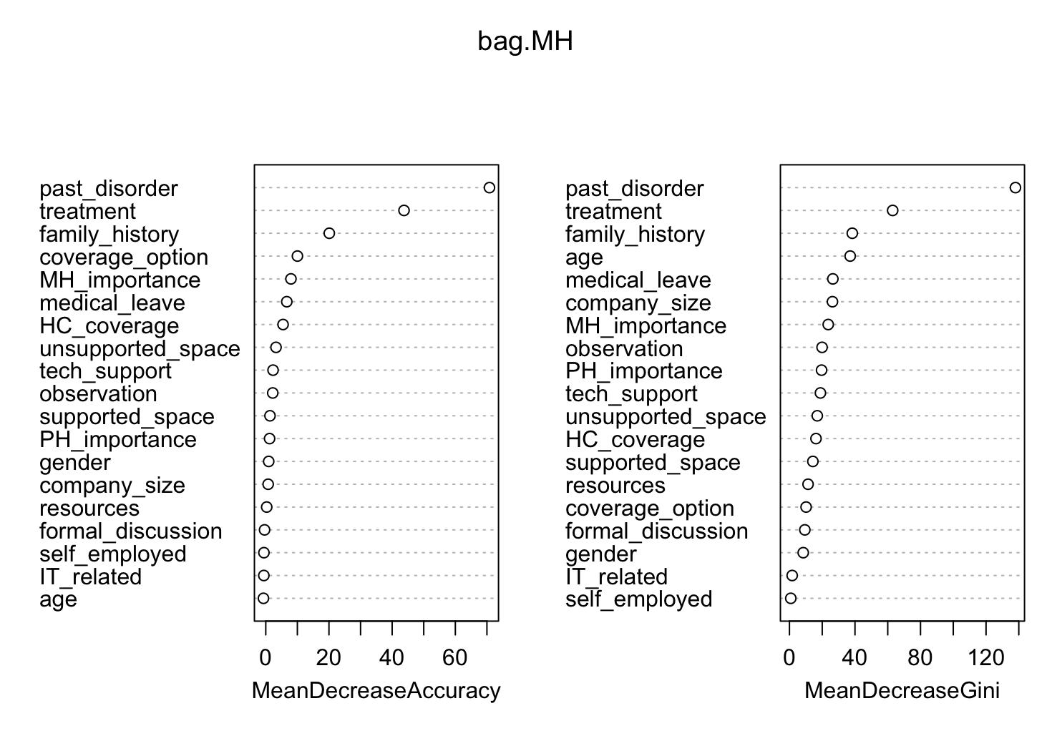
III
Data Mining Methods
Random Forest
Top 8 important variables
Using all variables except Countries
Accuracy (test data): 0.866
mtry=5
past_disorder, treatment, and family_history are important variables
Original tree
Random Forest Feature Importance Plot
12

Slide 13
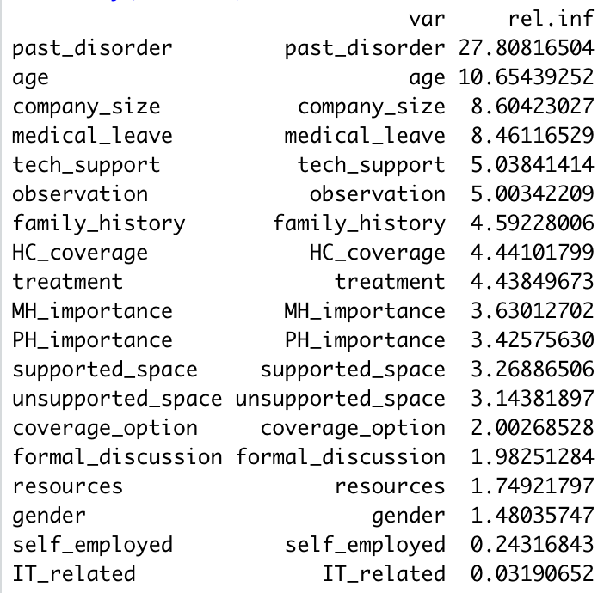
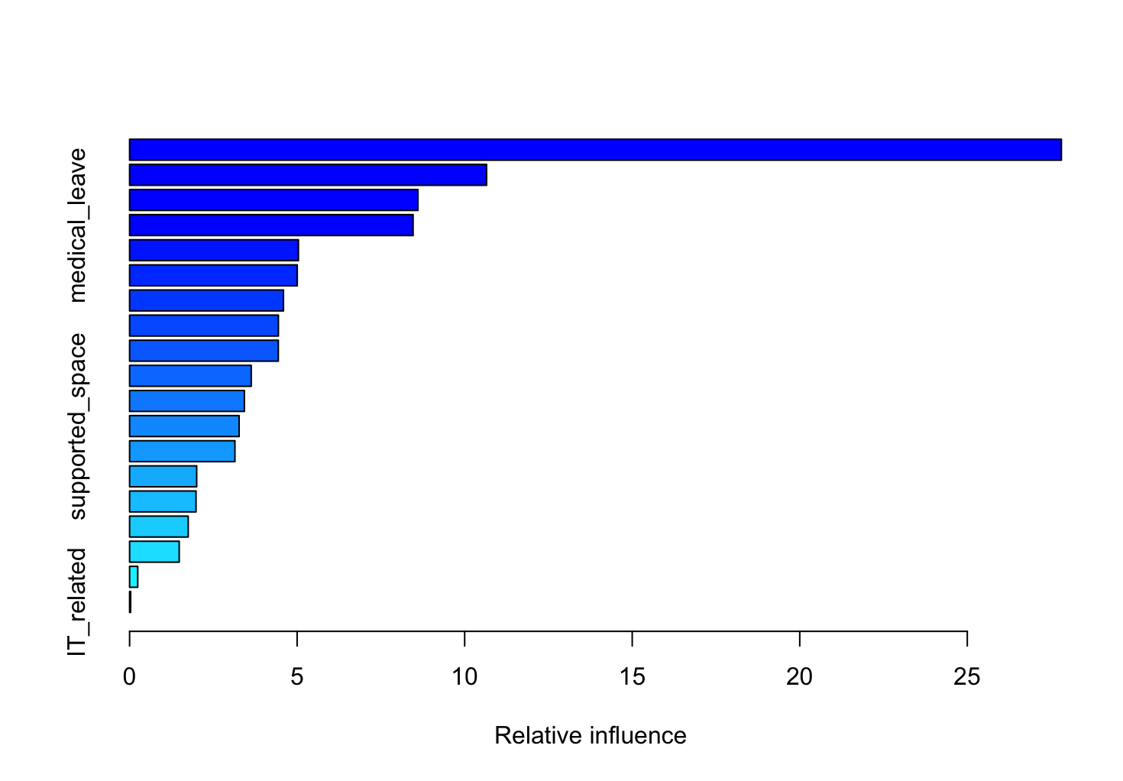
III
Data Mining Methods
Boosting
Using all variables except Countries
Accuracy (test data): 0.854
Importance of variables is similar from the Random Forest
13

Slide 14
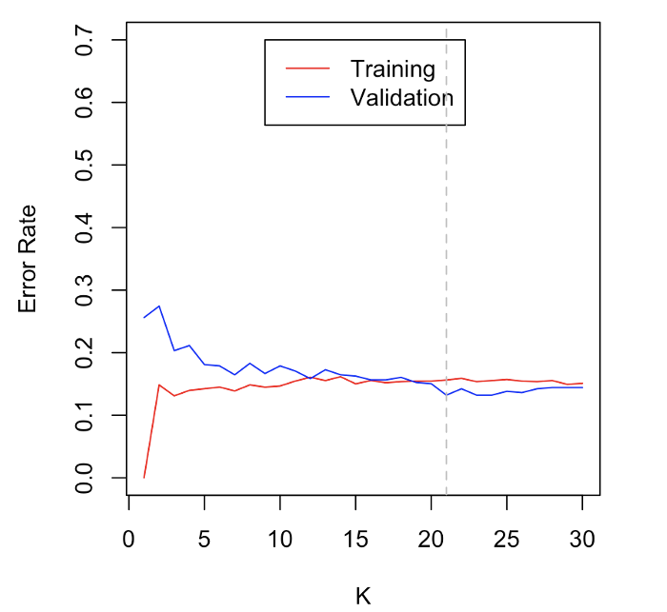
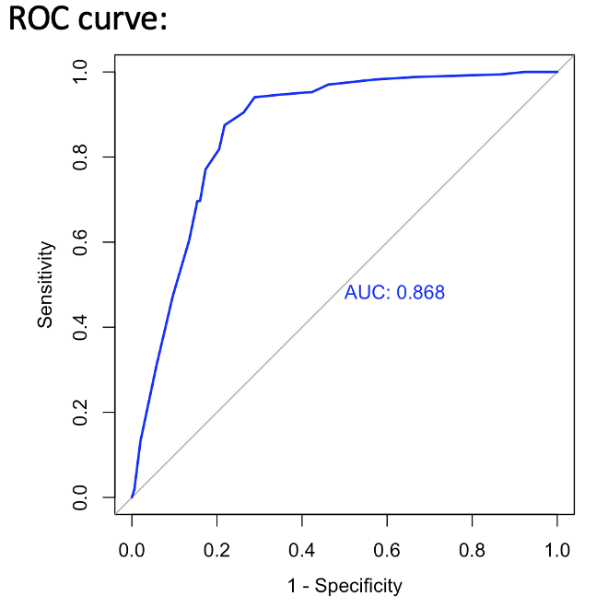
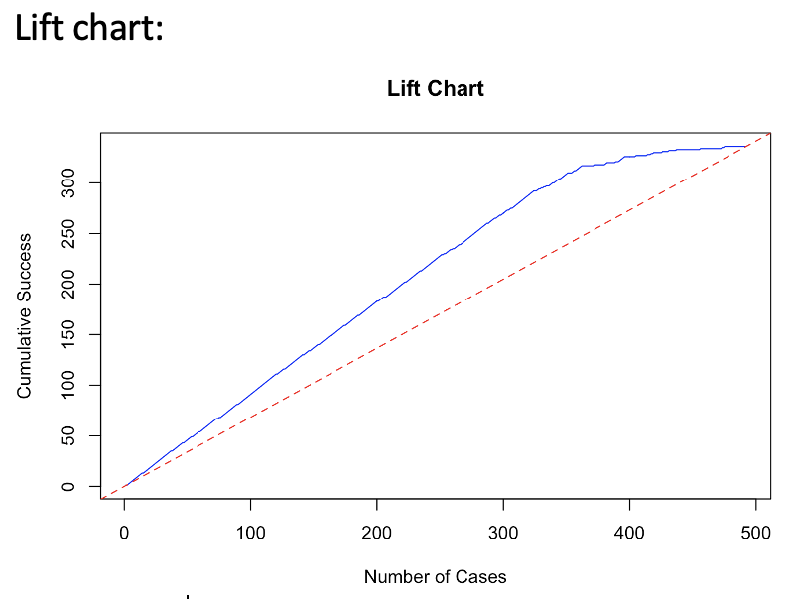
III
Data Mining Methods
KNN
Using all variables except Countries
Accuracy (test data) : 0.8678
AUC (test data) : 0.868
Lift Chart
ROC curve
Different Values of k vs.
Error Rate to find best k (21)
14

Slide 15
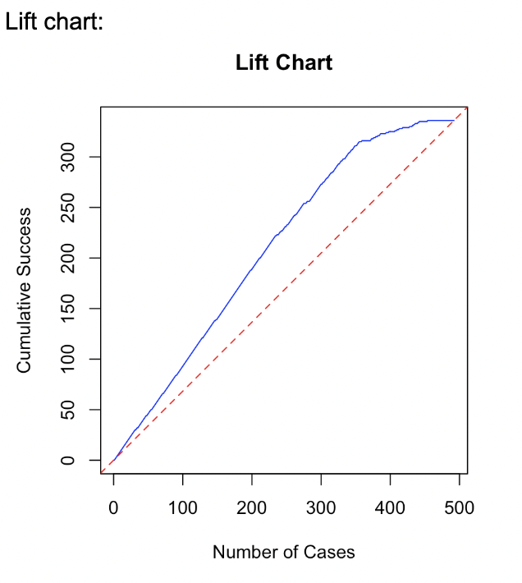
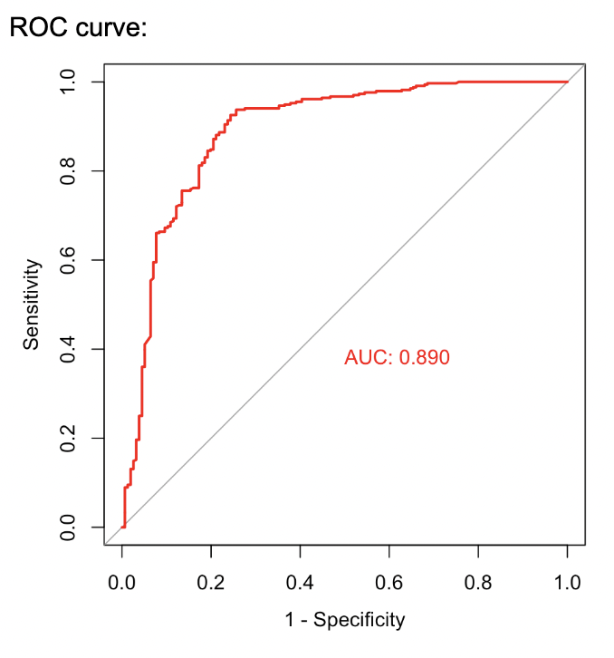
III
Data Mining Methods
Naïve Bayes
Using
Random Forest top 8 variables
Accuracy (test data) : 0.8516
AUC (test data) : 0.890
Lift Chart
ROC curve
15

Slide 16
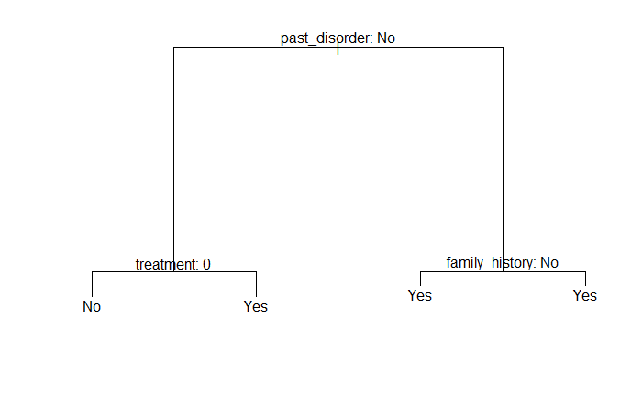
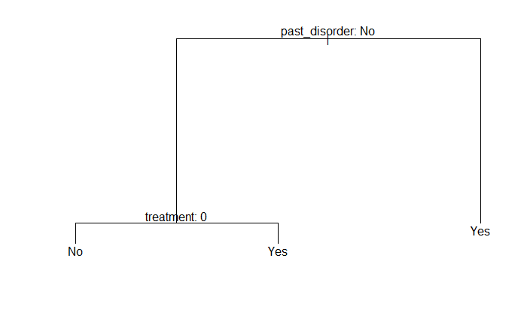
III
Data Mining Methods
Classification Tree
Using all variables except Countries
Have accuracy of 86% with only two categorical variables
Indicates these two variables are much more important compare with other features
Original tree
Pruned tree
16

Slide 17
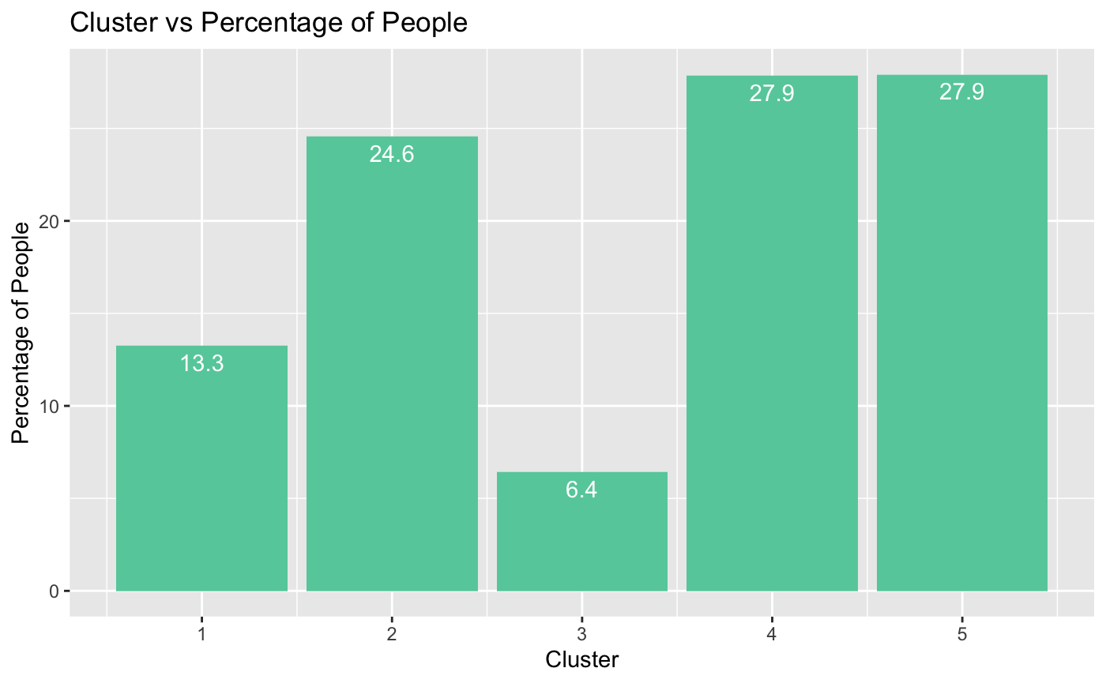
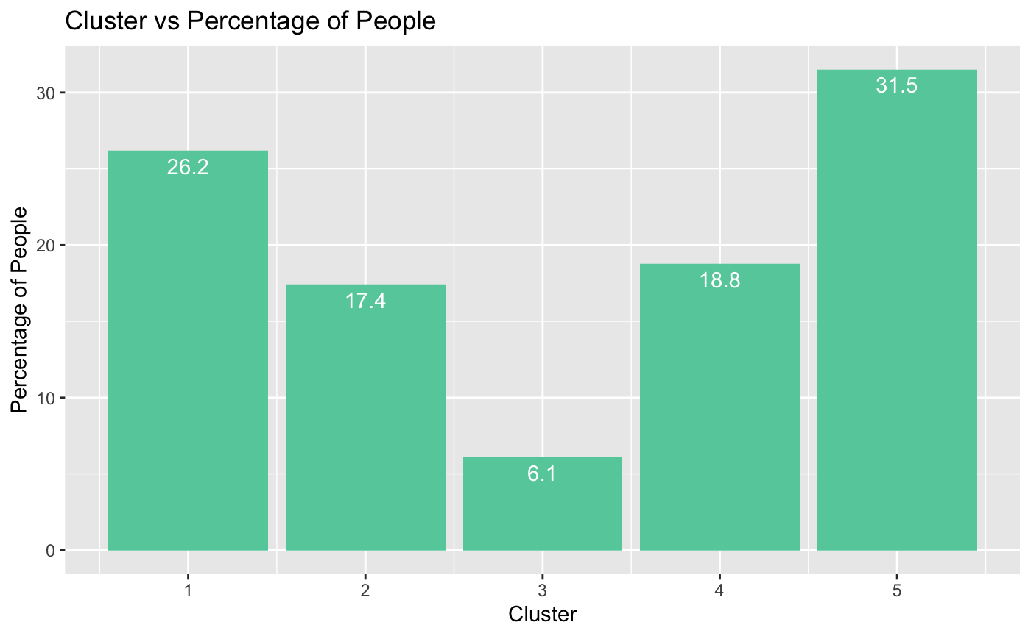
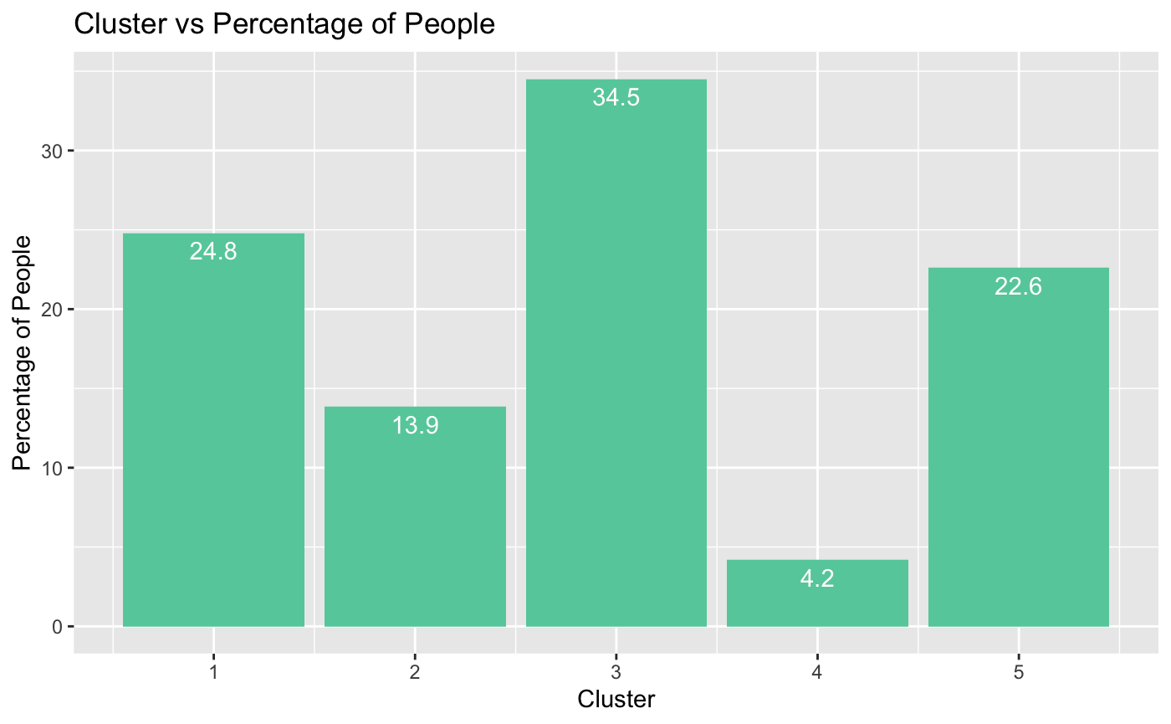
III
Data Mining Methods
Clustering
Using all variables
Max 27.9% of people having Mental Health Disorder are in Cluster 4,5
Using LogReg variables
Max 31.5% of people having Mental Health Disorder are in Cluster 5
Using Random Forest top 8 variables
Max 34.5% of people having Mental Health Disorder are in Cluster 3
17

Slide 18
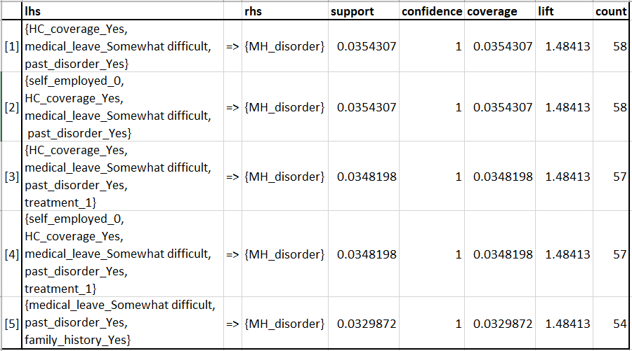
III
Data Mining Methods
Association Rules
Using all variables
Employees with their employers providing mental health benefits, facing somewhat difficulty in getting medical leaves, and having a history of past mental health disorder are more likely to have mental health disorders
18

Slide 19
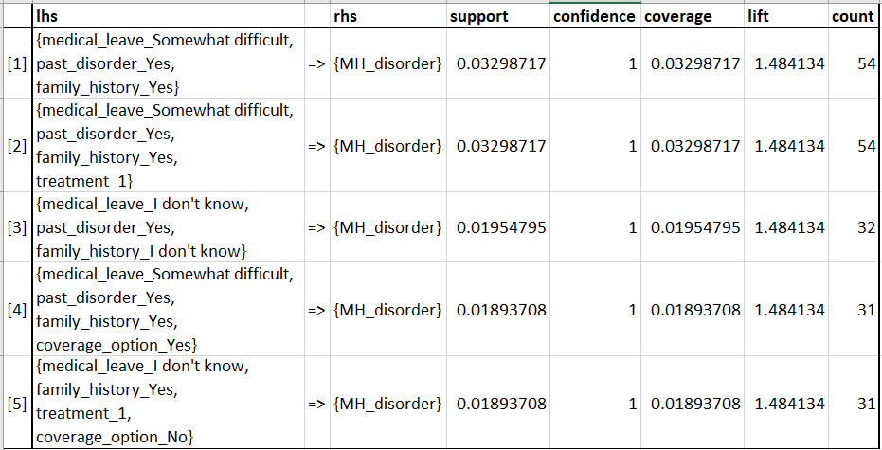
III
Data Mining Methods
Association Rules
Using LogReg variables
Employees facing somewhat difficulty in getting medical leaves, having a history of past mental health disorder, and having a family history of mental illness are more likely to have mental health disorders
19

Slide 20
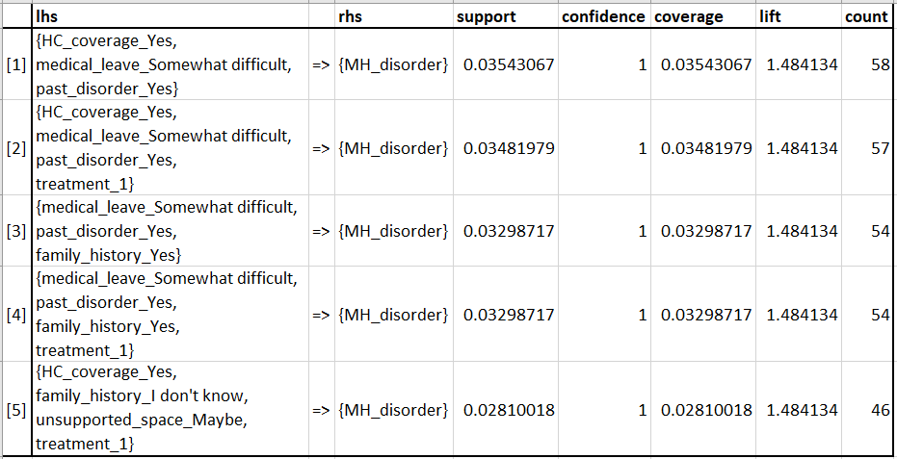
III
Data Mining Methods
Association Rules
Using Random Forest top 8 variables
Employees with their employers providing mental health benefits, facing somewhat difficulty in getting medical leaves, and having a history of past mental health disorder are more likely to have mental health disorders
20

Slide 21
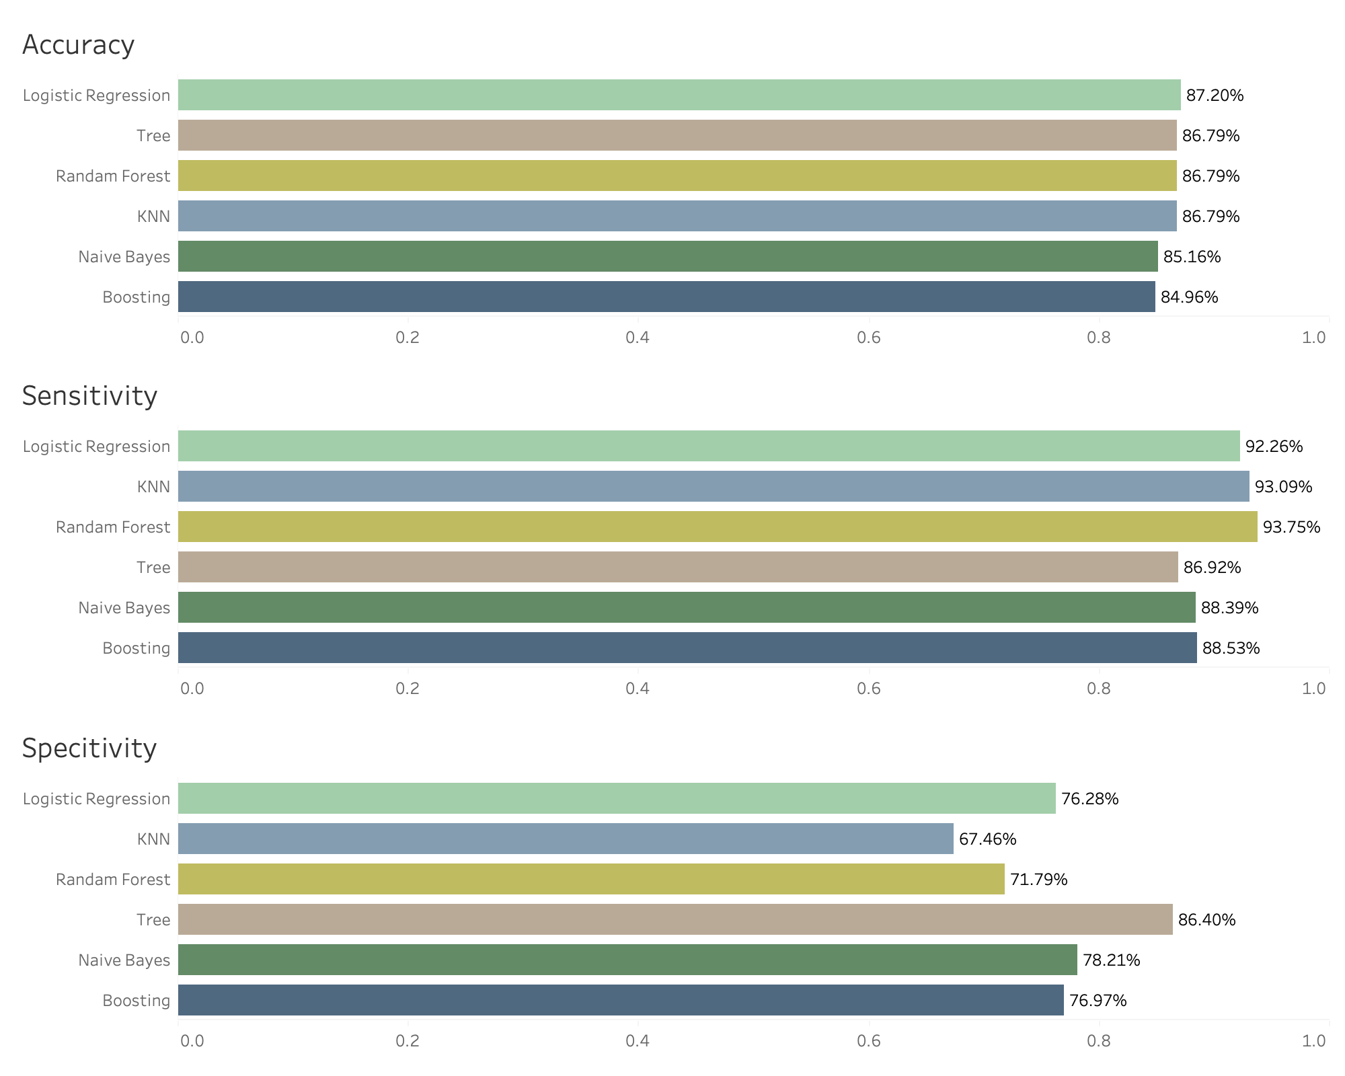
IV
Results and Finding
Selecting the best data mining model for the classification of poor mental health
Model | Accuracy | Sensitivity | Specificity
Logistic | 0.8720 | 0.9226 | 0.7628
KNN | 0.8679 | 0.9309 | 0.6746
Naive Bayes | 0.8516 | 0.8839 | 0.7821
Random Forest | 0.8679 | 0.9375 | 0.7179
Boosting | 0.8537 | 0.8853 | 0.7697
Tree | 0.8679 | 0.8692 | 0.8640
21

Slide 22

IV
Results and Finding
Factors related to poor mental health
Having personal as well as family history of past mental health disorder
Availability of mental health care in health coverage
How much importance is given to mental health in the company
Top 8 important variables
People working in tech roles/industry
Professionals working in the field of IT doesn’t correlate to being prone to mental health issues
Company and employee’s mental health
Ease of asking for a medical leave
Providing mental health benefits as part of the healthcare
Reception of other employees
22

Slide 23

V
Future Scope
Algorithmic Fairness
Researching the causes of bias in data and algorithms
Building machine learning models with no concept of race, ethnicity, gender or religion, actively discriminate against certain groups
Text mining
Perform text mining for the description feature to see the correlation of certain word and their mental health condition
Expand Dataset
Add data from other years or other surveys to increase the credibility of our models
Complex Modelling
Use complex modelling techniques like Neural Networks, Ensemble Methods etc
ML Interventions
Scope for future research to explore extensions of how ML interventions can become valuable tools to support the practices of mental health care experts.
23

Slide 24

Thank you!
Any Questions?
24

